Slide 1
Latent Semantic Analysis
Project by:
K Shreya PES2UG20CS150
Khushi Kedia PES2UG20CS161
Komalpreet Kaur PES2UG20CS164
Meghna Goyal PES2UG20CS193

Slide 2
What is Latent Semantic Analysis?
Latent semantic analysis (LSA) is a technique in natural language processing, in particular distributional semantics, of analyzing relationships between a set of documents and the terms they contain by producing a set of concepts related to the documents and terms.
LSA assumes that words that are close in meaning will occur in similar pieces of text.
E.g. Two Sports Document will have more similarity than a Sport and Movie Document.
This is because similar topic will have words which are close in meaning with that topic.

Slide 3
Why LSA?
Latent Semantic Analysis is a technique for creating a vector representation of a document.
Having a vector representation of a document gives you a way to compare documents for their similarity by calculating the distance between the vectors.
This in turn means you can do handy things like classifying documents to determine which of a set of known topics they most likely belong to.

Slide 4
Why LSA different from classification?
Classification implies you have some known topics that you want to group documents into, and that you have some labelled training data.
If you want to identify natural groupings of the documents without any labelled data, you can use clustering.
LSA uses words meaning to assign them to a Topic

Slide 5
workflow
First we have to form doc-term matrix of the TF-IDF(term frequency–inverse document frequency) scores of the word frequency in each document.
This matrix contain 1000’s of vector.
Then we will do the dimensionality reduction with SVD(singular-value decomposition)
The SVD step does more than just reduce the computational load–that is large number of features for a smaller set of better features.
Paragraphs are then compared by taking the cosine of the angle between the two vectors (or the dot product between the normalizations of the two vectors) formed by any two columns.
Values close to 1 represent very similar paragraphs while values close to 0 represent very dissimilar paragraphs.

Slide 6
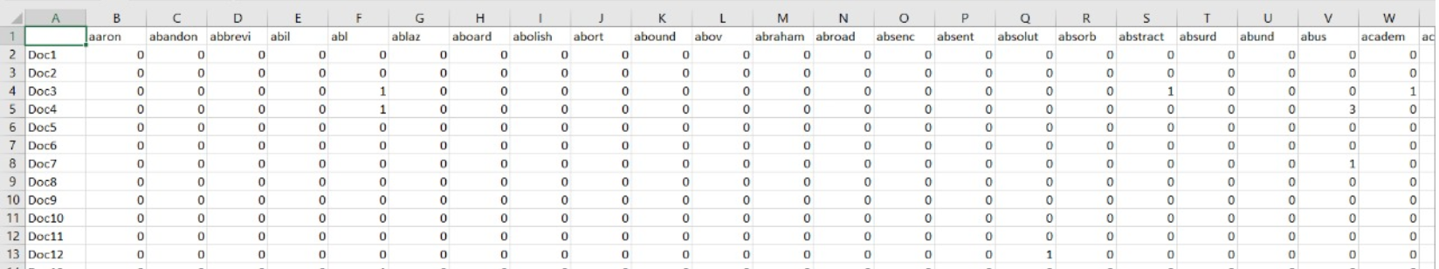
TF-IDF
Creating Document-Term Matrix for TF-IDF scores as will as Occurrence Score from the set of cleaned document.
We have 5272 Terms and 200 Documents.

Slide 7
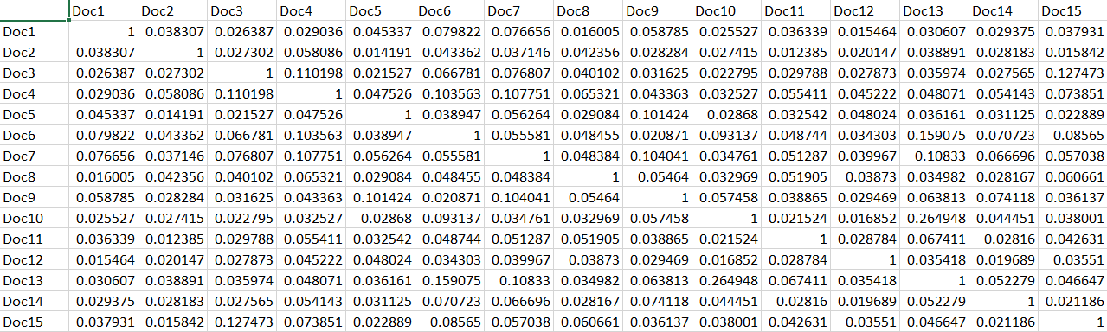
COSINE SIMILARITY
Now we will find cosine similarity to compare the similarity of the documents
Cosine similarity(Doc-Doc Matrix) = Doc-Term Doc-Term^{T}
The shape of the Doc-Doc Matrix is 200 X 200

Slide 8
LSA Implementation
LSA is a vector-based method that assumes that words that share the same meaning also occur in the same texts This is done by first simplifying the document-term matrix using Singular Value Decomposition (SVD), before finding close related terms and documents. This is done by using the principals of vector-based cosine similarities.

Slide 9
singular-value decomposition
In linear algebra, the singular-value decomposition (SVD) is a factorization of a real or complex matrix.
It is the generalization of the eigen decomposition of a positive semidefinite normal matrix (for example, a symmetric matrix with positive eigenvalues) to any m × n matrix via an extension of the polar decomposition.
Co-occurring values of N projected over dimensions R.
It has many useful applications in signal processing and statistics.
In the project, dimensionality reduction is done using SVD.
Truncated SVD: largest singular values and the corresponding matrices
Weighted word features found using truncated matrix.

Slide 10
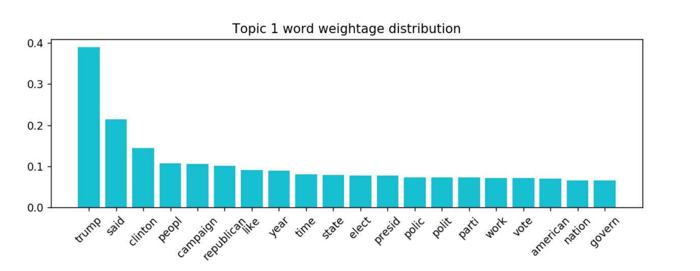
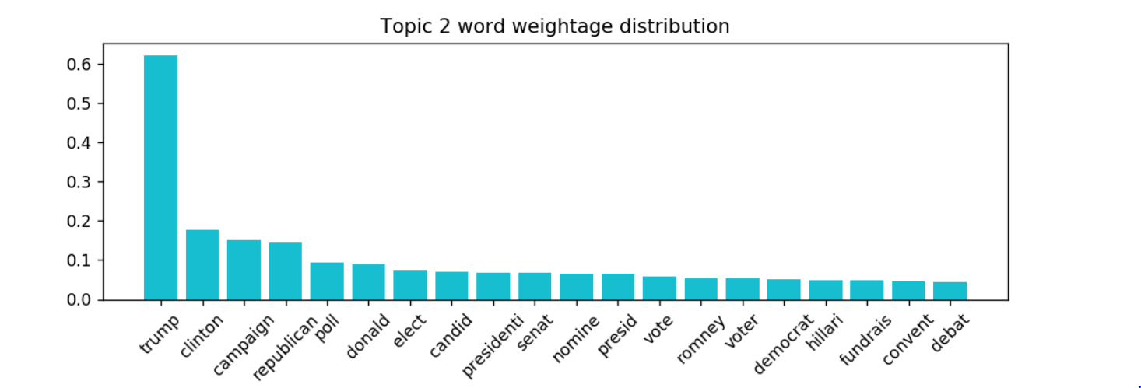
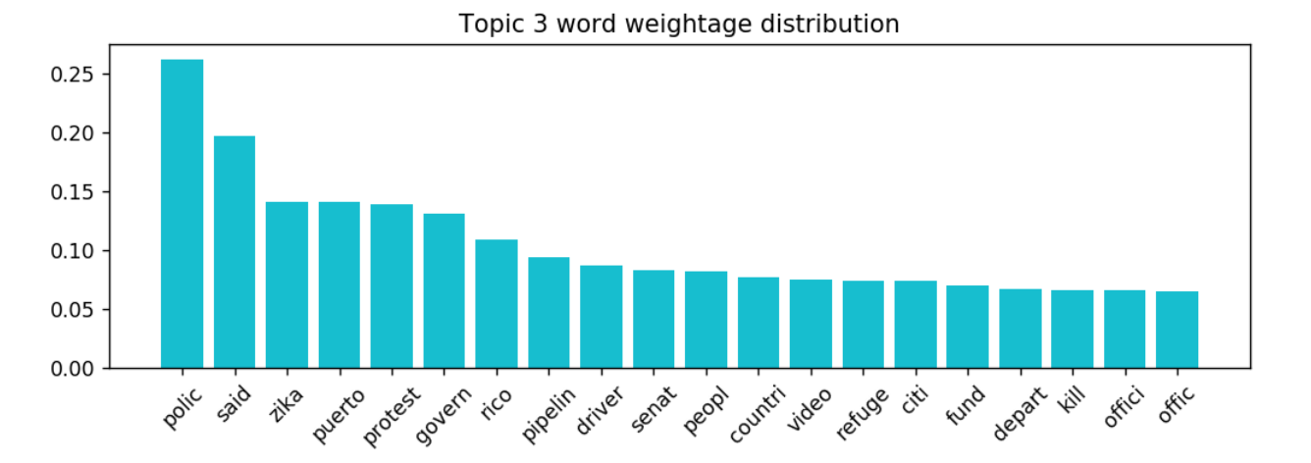
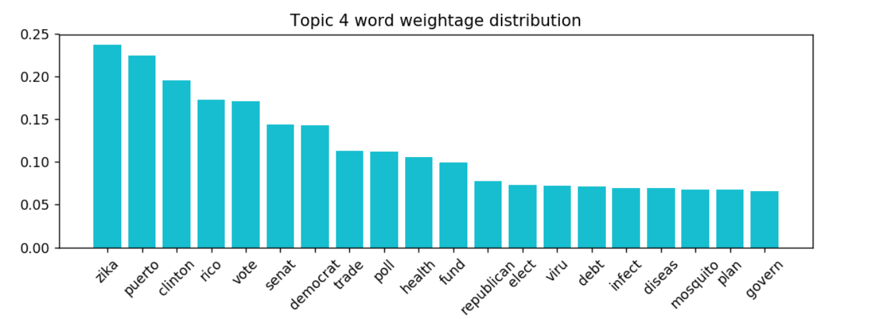
TOPIC’S TOP 20 WORD WEIGHT
Feed the Doc-Term matrix of TF-IDF score to the SVD model with n-component equals to 5(let suppose).
It will return 5 topic i.e. all the words for a topic with different weight.
The shown figure is the topic 4 and 5 for top 20 words with different weight assigned to it.

Slide 11
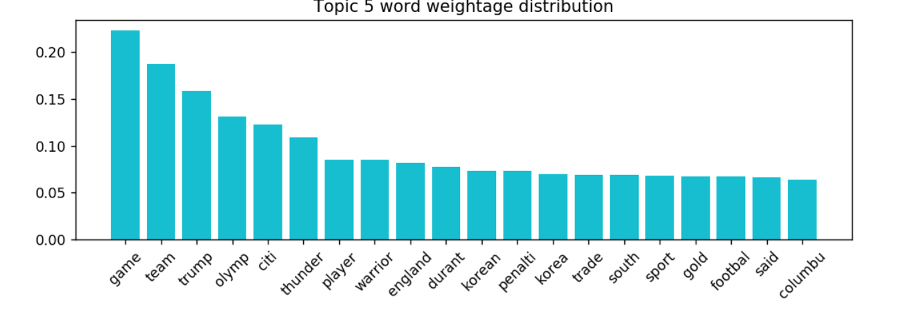

Slide 12
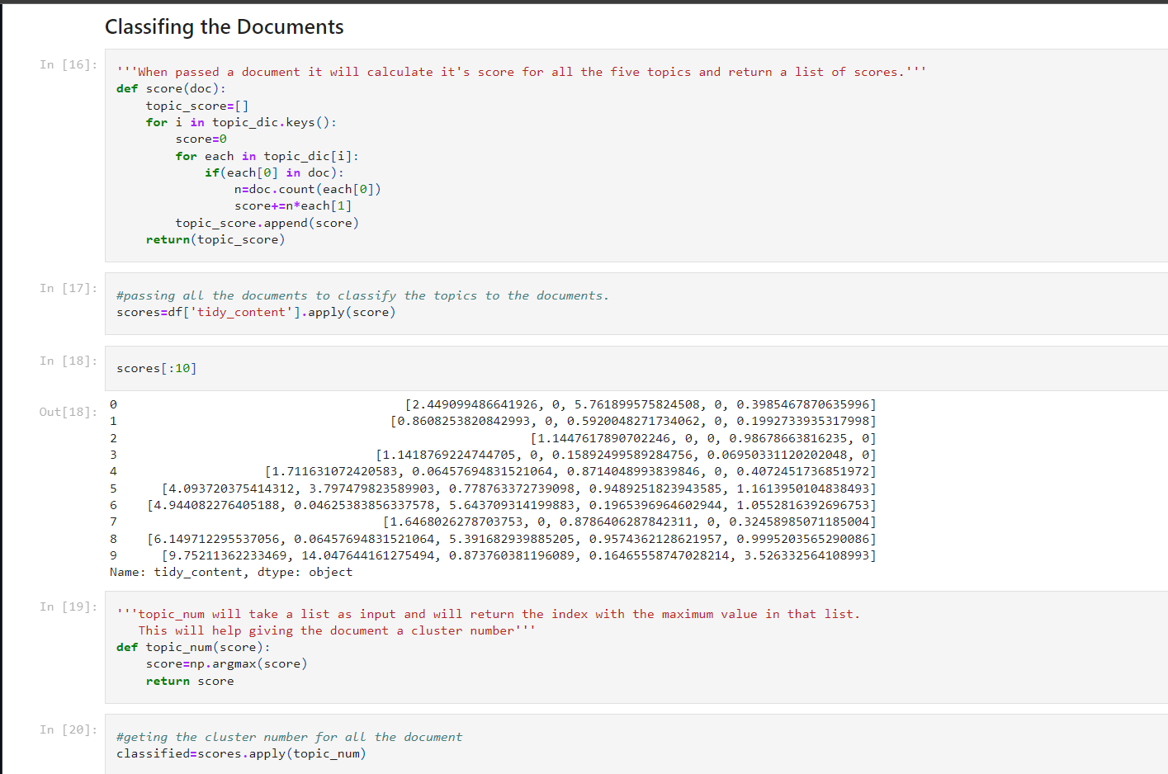
CLASSIFICATION OF DOCUMENTS
A machine learning method used to classify the documents in a truncated and simplified manner.
Based on the weights calculated in SVD, the weight score for documents are calculated depending on the number of times each word occurs in that particular document. The document is assigned to the topic with the highest weight score.

Slide 13
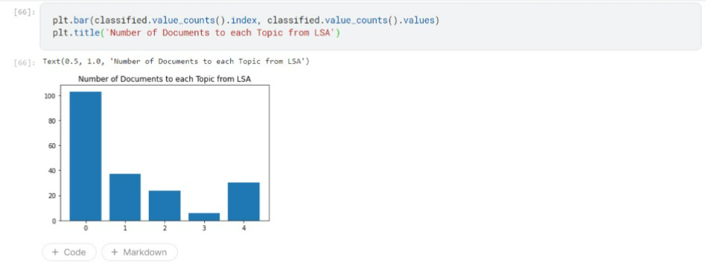
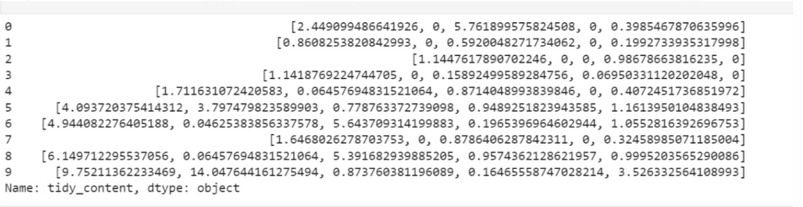
Classification of Documents

Slide 14
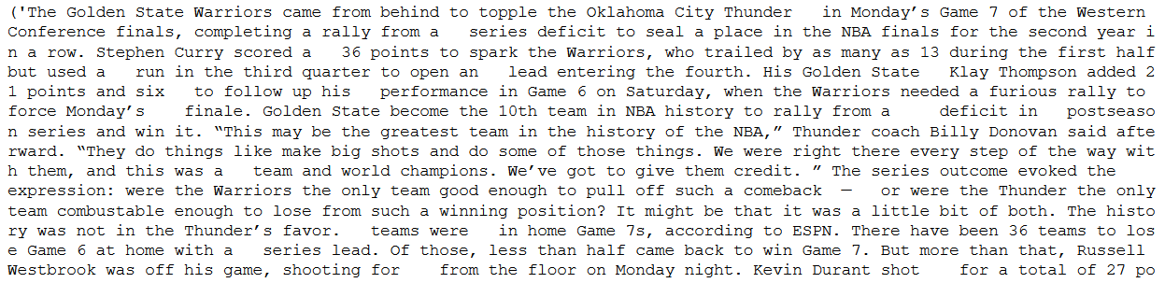
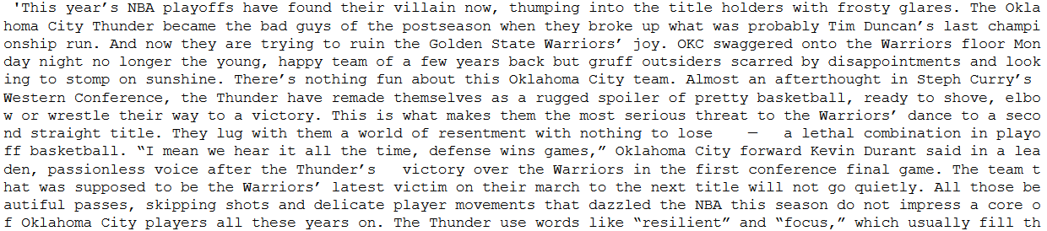
Max similarity in two Documents.
The max Similarity is 0.660201496884226

Slide 15
K-Means Clustering
k-means clustering aims to partition n observations into k clusters in which each observation belongs to the cluster with the nearest mean, serving as a prototype of the cluster. This results in a partitioning of the data space into Voronoi cells.
First we initialize k points, called means, randomly.
We categorize each item to its closest mean and we update the mean’s coordinates, which are the averages of the items categorized in that mean so far.
We repeat the process for a given number of iterations and at the end, we have our clusters.

Slide 16
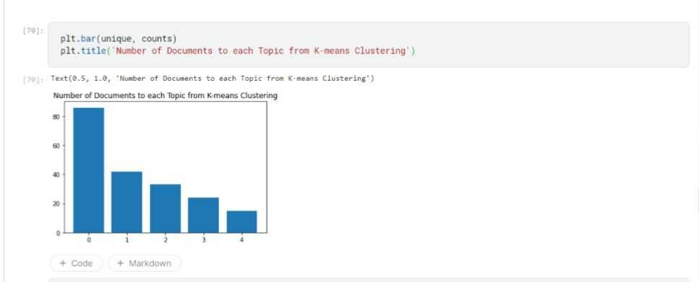
K-Means Clustering

Slide 17
Comparison of LSA and K-Means Clustering
Total Document pair possible from 200 documents is 19900
Total Document Pair classified in same Topic through LSA Method is 6645.
Total Document Pair classified in same Topic from K-means out of those 6645 document is 3707.

Slide 18
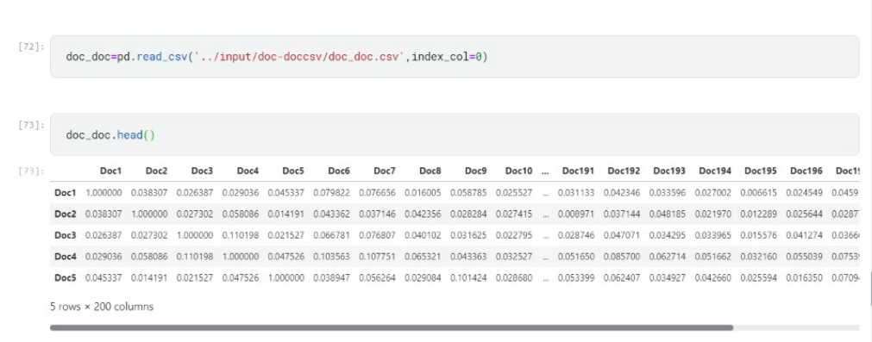
Comparison of LSA and K-Means Clustering

Slide 19
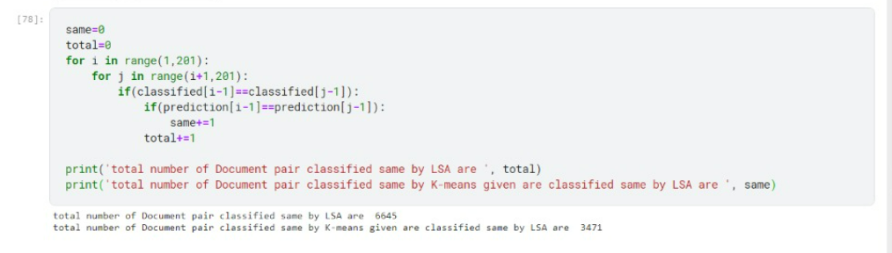
Comparison of LSA and K-Means Clustering
There are total 6645(May vary with execution) Document pair where LSA has assigned same topic, out of which only 3016(may vary with execution) are assigned to same topic by K-Means clustering.

Slide 20
APPLICATIONS
Matrix generated after cosine similarity can be used for plagiarism check on a large scale
Data categorisation method can be used to observe which topics are trending
The most in-use keywords for each topic can be determined.

Slide 21
Thank You

